Slide 1
Emerging stronger:
How companies can improve family outcomes & costs

Slide 2
Thank you for joining us today
Stephanie Holzwarth
SALES DIRECTOR
MAVEN

Slide 3
The State of
Family Benefits

Slide 4
The expectation
Get
pregnant
Have a baby
Return to work

Slide 5
The real complexities of the family journey
More tests
Mental health support
Grief counseling
Miscarriage
High-risk assessment
Get
pregnant
Preconception care
Considering 1st IVF cycle
1st IVF
cycle
2nd IVF
cycle
Gestational diabetes
Genetic counseling
NICU
Breastfeeding issues
Sleep regression
Have a baby
Return to work
Postpartum depression
Growth
spurt
Solids
Food
allergies

Slide 6
Addressing care gaps in women’s and family health has never been more important
WORSENING OUTCOMES | LACK OF ACCESS TO CARE | COSTLY INTERVENTIONS | INCREASED ATTRITION & ABSENTEEISM
Black women are 3x more likely to die from pregnancy related causes ¹ | of U.S counties are maternity care deserts ² | The average cost of fertility treatment ³ | of women have left or are considering leaving work due to menopause symptoms⁴
3x
36%
23k
17%
¹PRB: Black women over three times more likely to die in pregnancy, postpartum than white women, new research finds
² NIH: 36% of US counties are 'maternity care deserts,' raising risks for women and babies, new report finds
³ NIH: Costs of infertility treatment: Results from an 18-month prospective cohort study
⁴ BIOTE Women in the workplace survey:

Slide 7
Filling the gaps
in care with
fertility & family health benefits
64%
OF EMPLOYEES
6%+
have missed work in the past year because of their family health needs²
COST INCREASE
The expected increase in health benefits cost in 2024¹
36%
How are employee family health needs impacting employers?
OF EMPLOYEES
have left or considered leaving a job because of inadequate family benefits²
¹WSJ: Health-Insurance Costs Are Taking Biggest Jumps in Years
²Maven: State of Fertility and Family Health Benefits in 2023

Slide 8
The role
HR leaders play

Slide 9
Addressing DEI, health equity,
and costs through family
health benefits
HR leaders have an important role to play in reducing health inequities and driving better health outcomes for all
Centering parents and parents-to-be in your DEI program ensures no one is left behind
Taking an outcomes-driven approach drives down costs for the employee and employer

Slide 10
Moving beyond check the box to
drive better outcomes & manage costs
One-Size-Fits-One Care
financial, clinical,
& emotional
continuity for
non-linear journeys
all paths to parenthood
accessibility with fast response times
white glove navigation

Slide 11
How well would your employees say your fertility & family benefits support them?
AUDIENCE QUESTION
1
Extremely well We offer comprehensive support for all employees
2
Pretty well
We cover the majority aspects, but there are still some gaps in care
3
Not that well We offer one or two benefits that support families, but that’s it
4
Not well at all We only offer what employees get through their traditional health insurance

Slide 12
Uncertainty and change create opportunities
63%
plan to increase their family health benefits in the next two to three years
OF EMPLOYERS
71%
added or are planning to add benefits or policies to accommodate reproductive health needs
OF EMPLOYERS
87%
say that family benefits are extremely important to prospective and current employees
OF EMPLOYERS
Maven: State of Fertility and Family Health Benefits in 2023

Slide 13
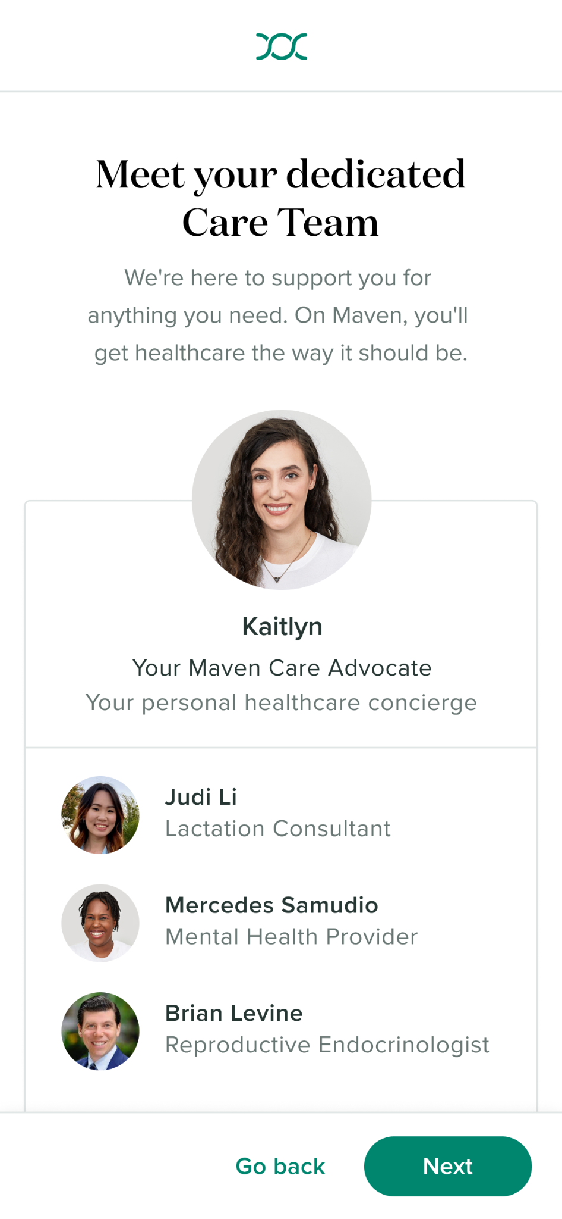
Maven’s approach to care:
24/7 clinical, emotional, and financial support across the family journey
Global platform with 24/7 access to 35+ different types of care specialists and experts
Clinician-designed programs for fertility, maternity, parenting, pediatrics & menopause
Easy-to-use financial tools to manage costs
17 million covered lives
90% return to work
175+ countries supported
4x return on investment

Slide 14
Thank you
MAVENCLINIC.COM

